Slide 1
How to Make Heart Origami bookmarkers
Chorei by: Rochelle Muñoz

Slide 2
Materials:
Paper
Optional: Tape
Optional: Scissors
Optional: pens/markers, etc. for decorating.

Slide 3

1. Get your paper and cut paper into a square.

Slide 4
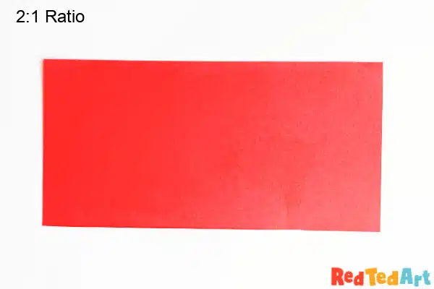
2. Cut Square paper into two
(two strips)

Slide 5
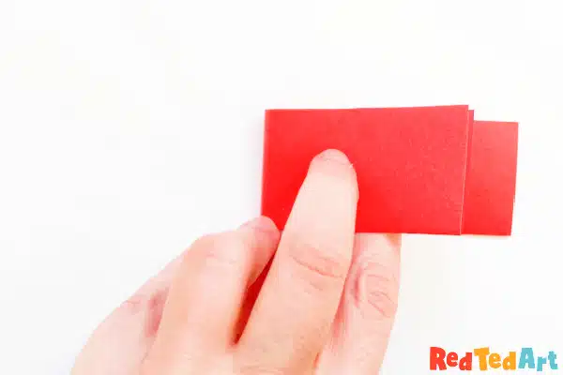
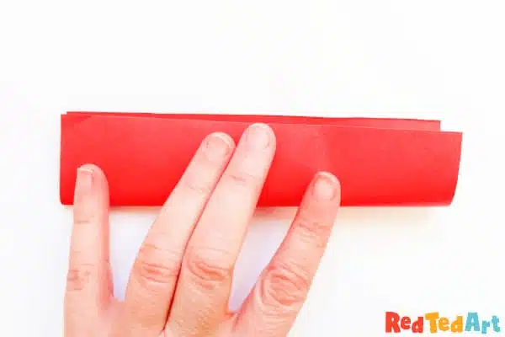
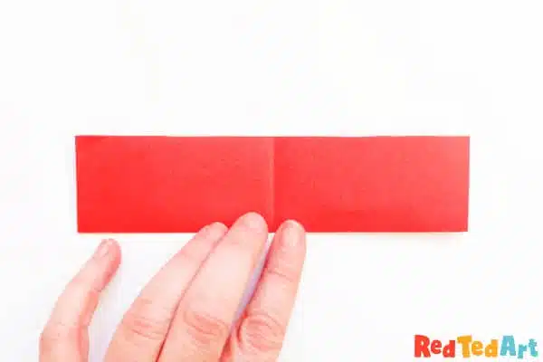
4. Fold half across
3. Fold strip in half

Slide 6
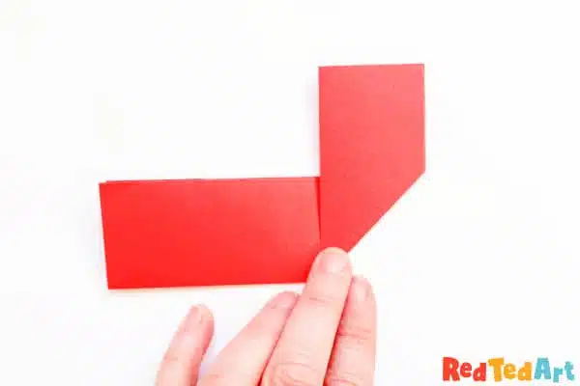
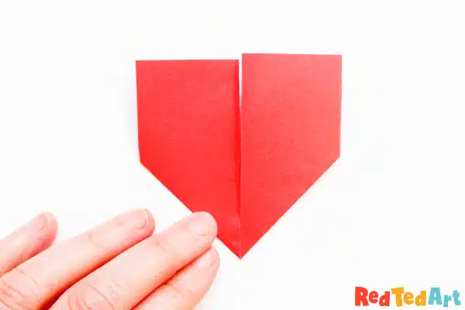
5. Fold up the heart’s sides

Slide 7
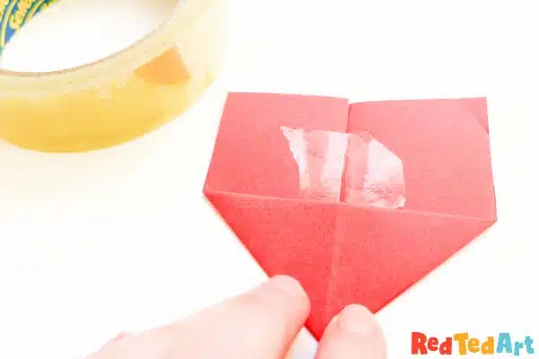
6. Optional: You can secure the back with tape.

Slide 8
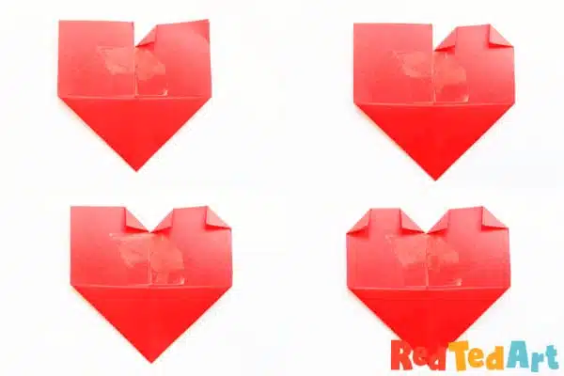
7. Turn down the corners of the top flaps to shape the top of the heart. Take turns on each corner.

Slide 9

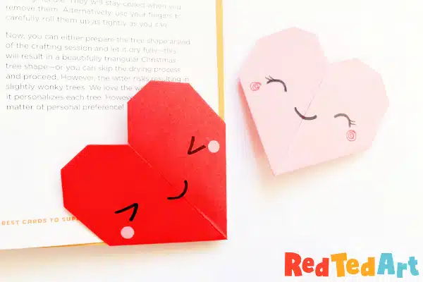
8. Time to decorate.

